Slide 1

Don’t Get Phished
Signs and Red Flags From the Perspective of an Incident Responder
Jason Killam

Slide 2
About:config (me)
Work at Jack Henry and Associates for three years performing digital forensics and incident response (DFIR)
Nine Years in the Marines as a Data Network Specialist.
Currently an Air Force Reservist working as a Cyber Warfare Specialist
Certificate Soup: GCFA, GCFE, Security+, Network+, A+, SSCP
Twitter: @killamjr
IT Support for my parents

Slide 3
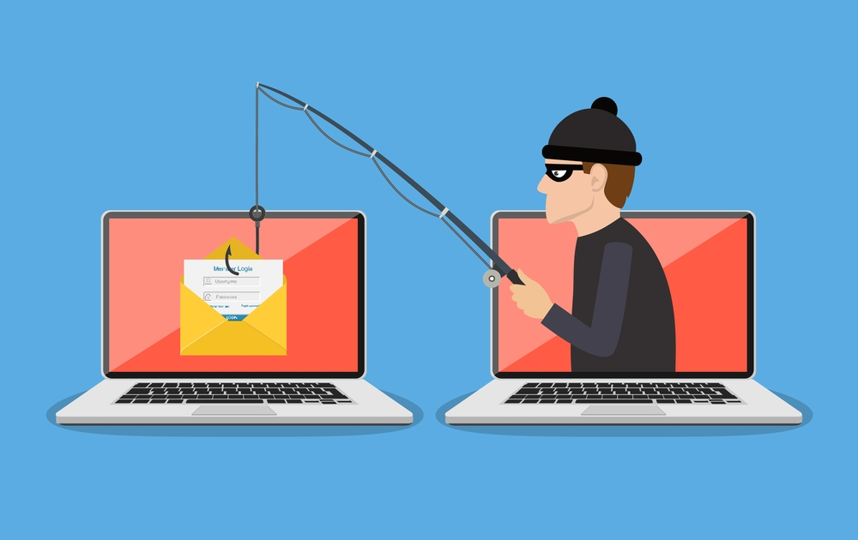
What is Phishing?
Phishing is the fraudulent attempt to obtain sensitive information such as usernames, passwords and credit card details, often for malicious reasons, by disguising as a trustworthy entity in an electronic communication.

Slide 4
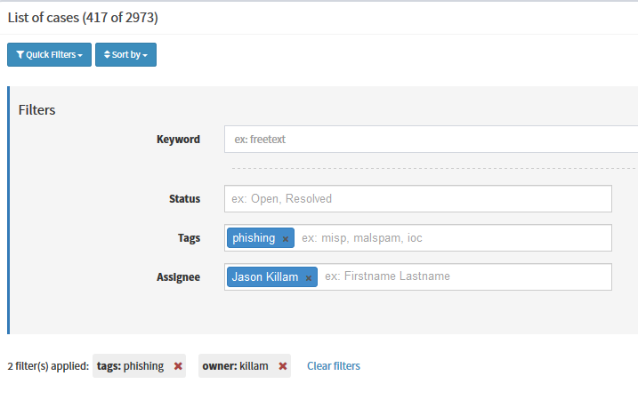

417 phishing cases – since 2017

Slide 5
Misconceptions About Phishing
HTTPS!=Safe
The push for HTTPS everywhere, has resulted in compromised sites hosting phishing pages unwittingly
Let’s Encrypt makes getting a HTTPS certificate for free easy
Good Spelling/Grammar doesn’t make it safe!
Phishers use what are called “Phishing Kits” which are basically plug ‘n play templates for building phishing sites and templates for phishing emails
Malware as a Service (MaaS) – for only a few bucks a phisher can purchase everything necessary to send out phishing emails and not have to code or write any emails themself

Slide 6
Misconceptions (Cont.)
If it’s hosted on a domain owned by a reputable company it’s safe
Nope – there is a recent trend of phishing pages hosted on “Trusted” domains using different methods
For something like this it’s important to pay attention to the full URL and domain
https://www.bleepingcomputer.com/news/security/phishing-report-shows-microsoft-paypal-and-netflix-as-top-targets/

Slide 7
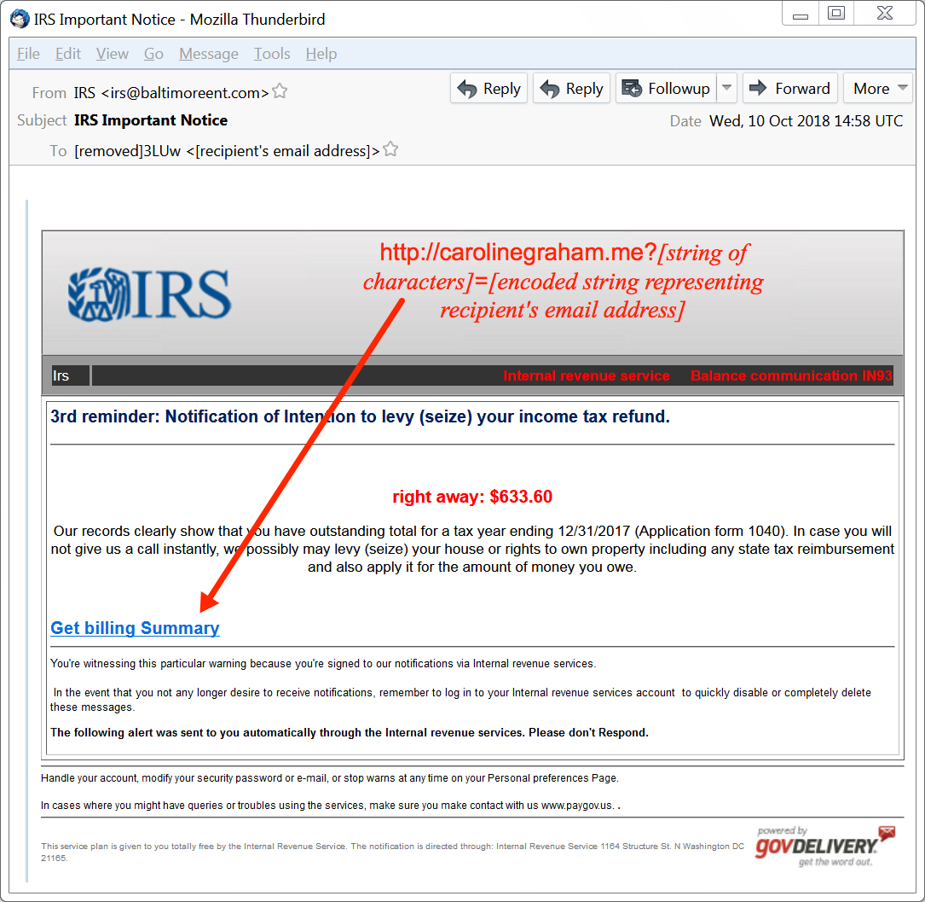
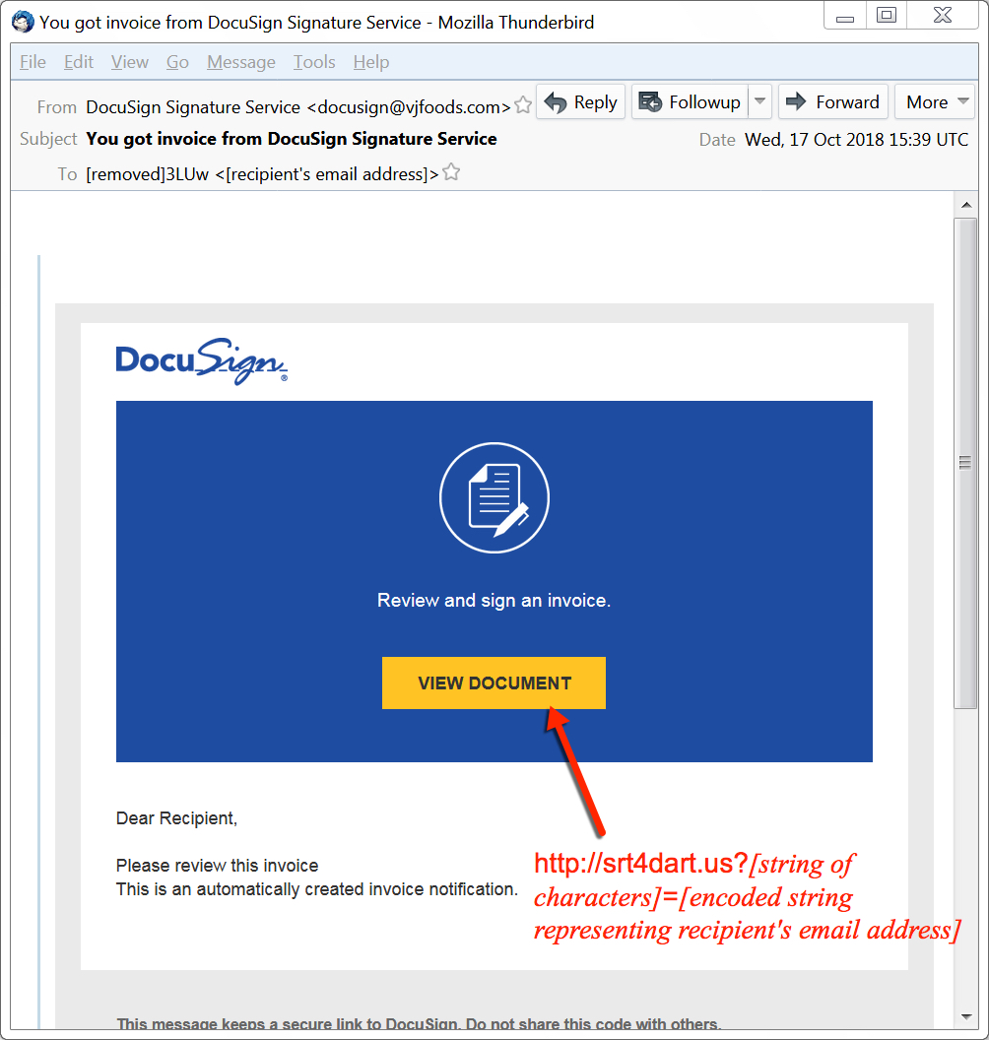
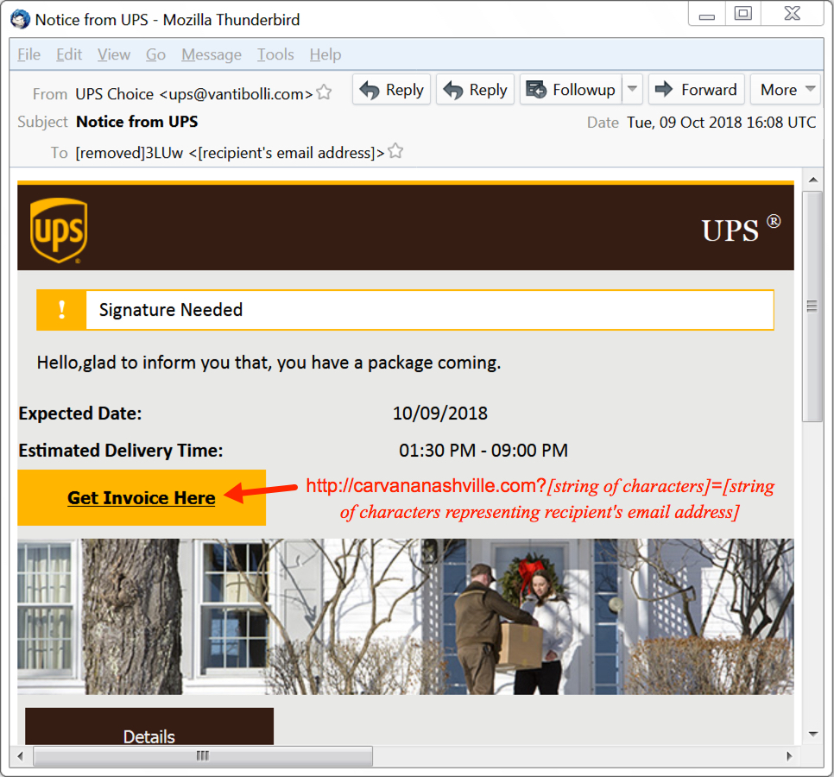
Hancitor Email Examples
Malicious email campaign that delivers a banking trojan

Slide 8
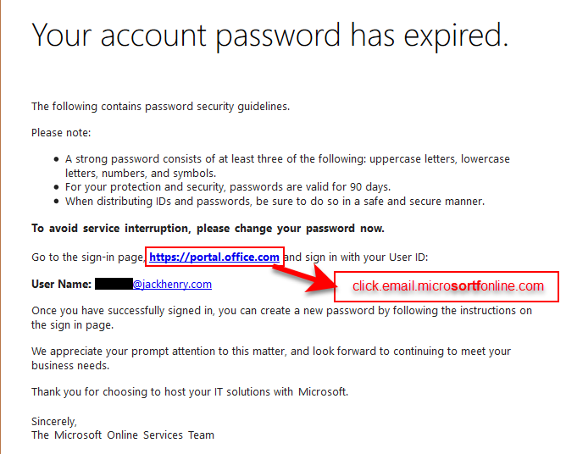
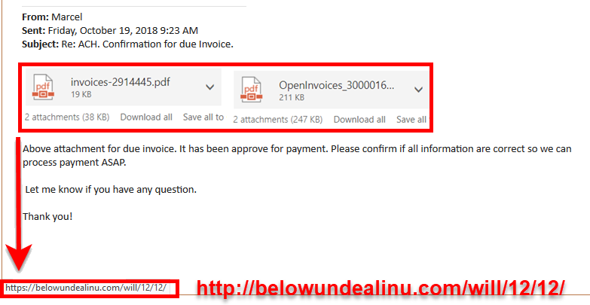
Phishing Email Examples

Slide 9
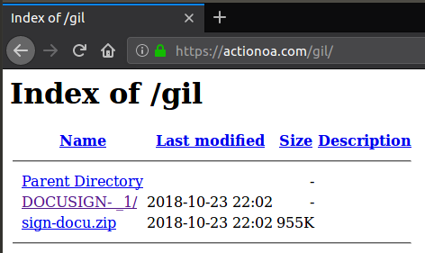
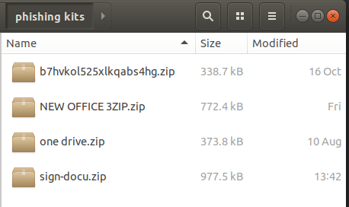
Phishing Kits
A phishing kit is basically a zipped up collection of files a bad guy can unzip on a compromised or server they own to quickly setup a phishing page
So surely something so useful to a bad guy wouldn’t be left behind by a the phisher right?

Slide 10
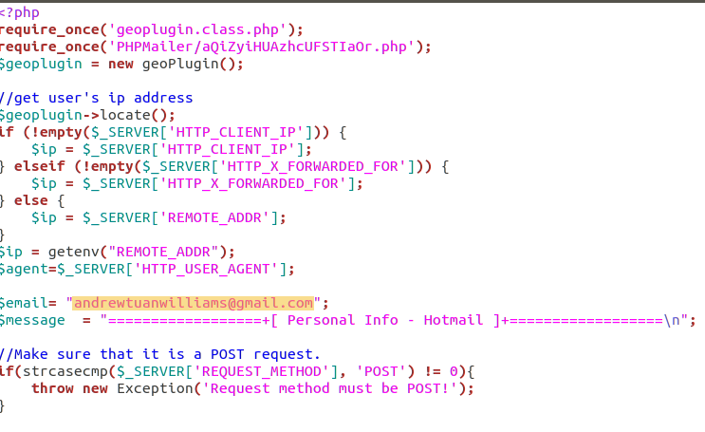
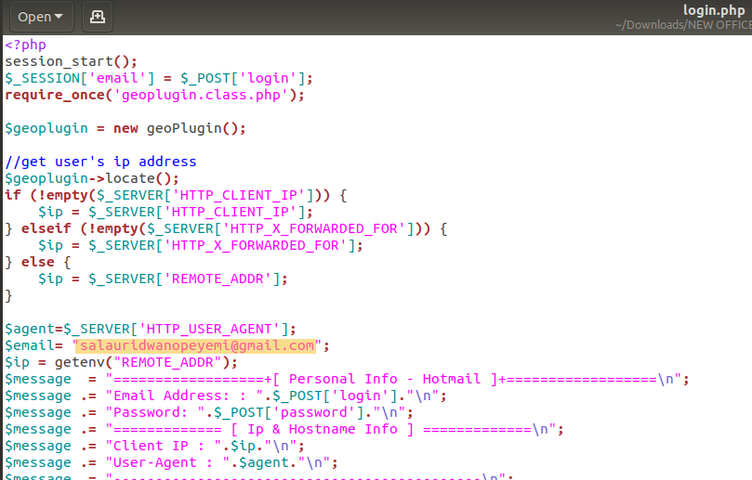
Phishing Kits (Cont.)
Digging through the phishing kits usually yields the email address where the account info is being mailed
These are usually compromised accounts, and should be reported to their respective email providers

Slide 11
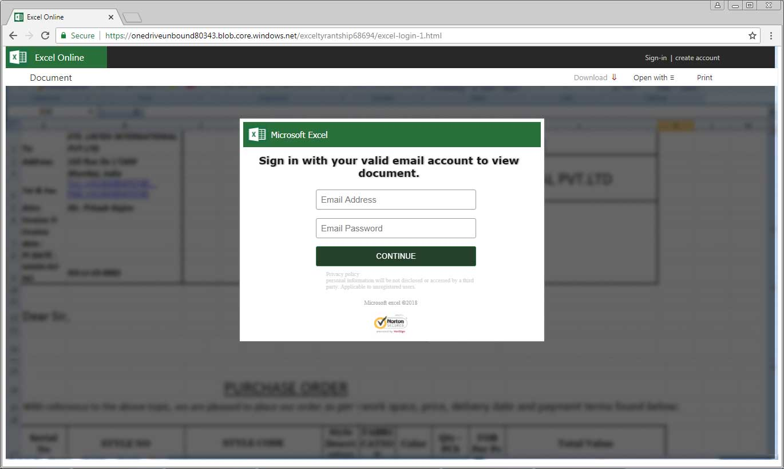
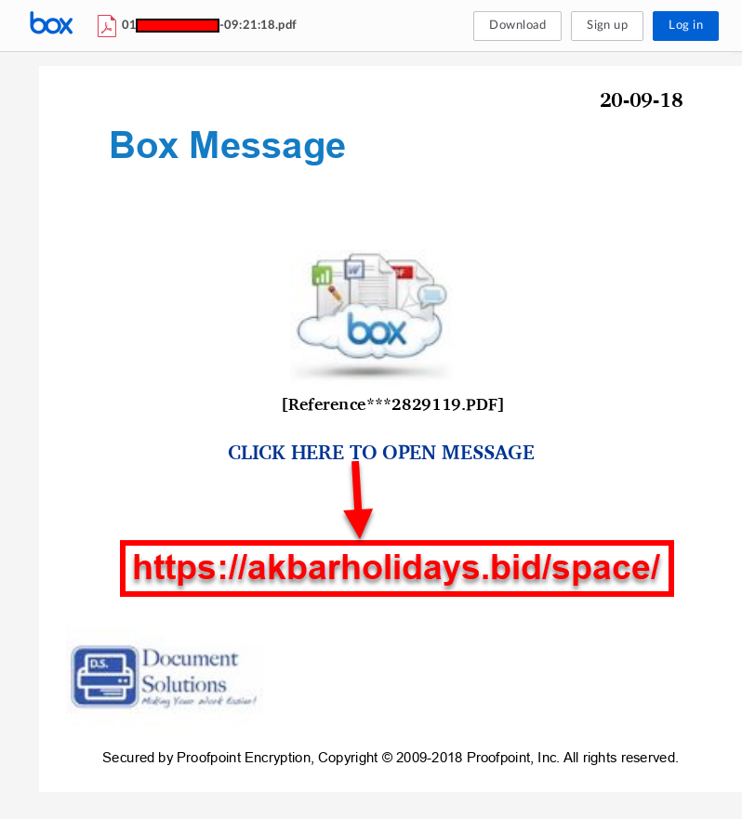


Slide 12
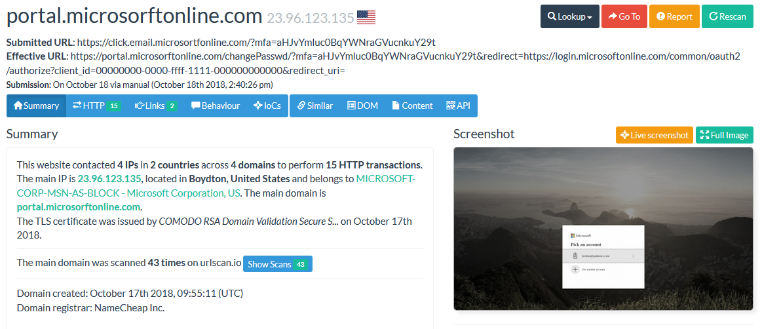
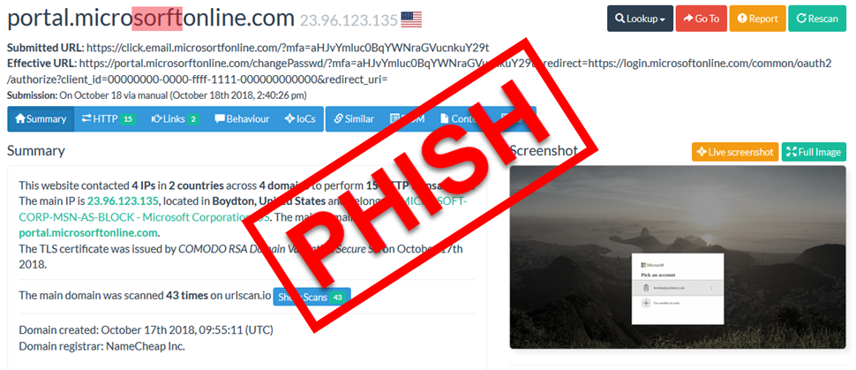
Office365 Phish
MicroSORFT

Slide 13
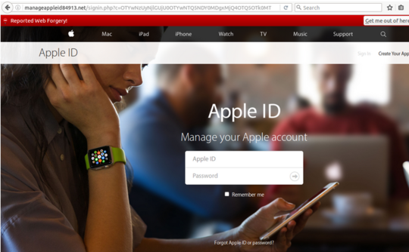
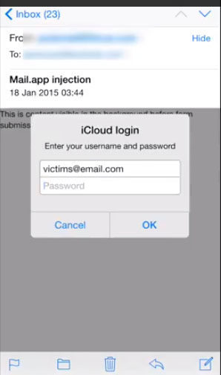
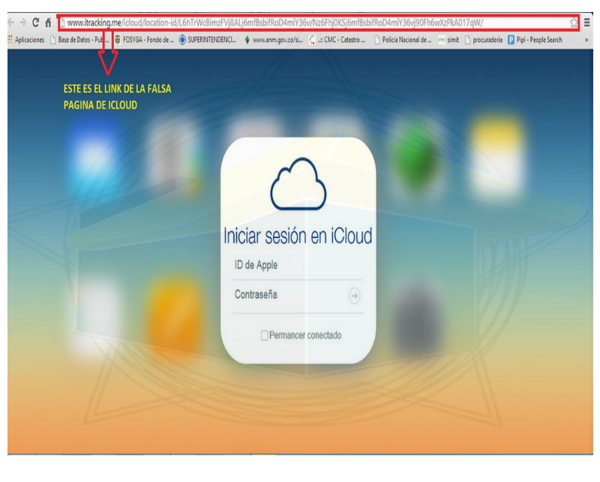
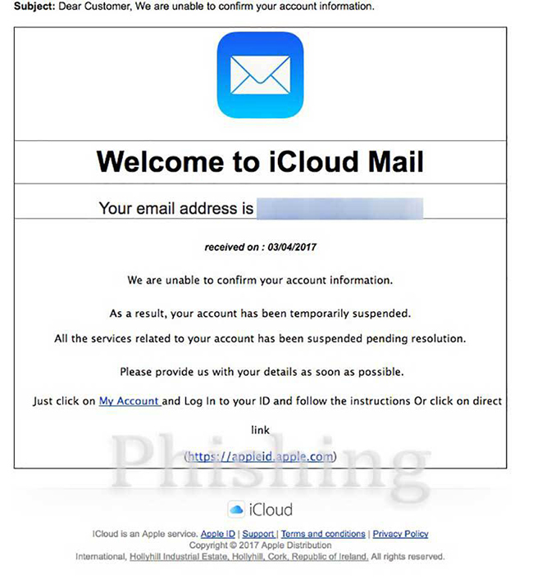

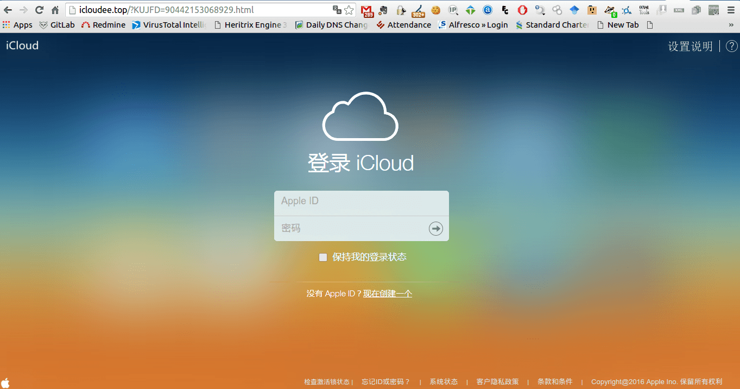
Misconceptions (cont.)
But I use a Mac! So I’m safe right?
Oh my sweet summer child

Slide 14
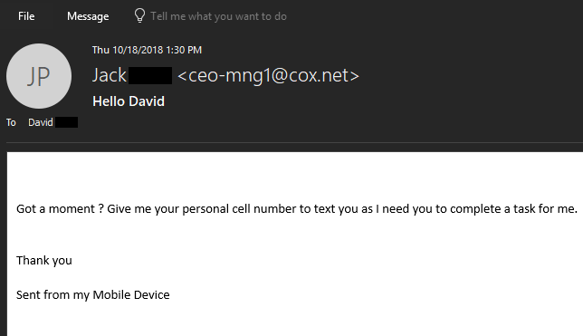
Business Email Compromise
A special type of email phishing where the Phisher poses as a high level executive to request an employee do something for them:
Wire Transfer
Send W-2 forms (tax refund fraud)
Send gift cards loaded with money

Slide 15
So what should I look for in a Phishing Email?
Anything instructing you do things like “Login” or “Verify Account Details”
Unexpected Emails using phrases related to money or legal action
keywords like remittance, ACH, invoice or wire transfer
Misspellings still occur, but they’re not as obvious – pay attention to the sender and From field.
Unexpected emails from contacts
If something seems amiss with email from a contact of yours, call to verify
Mouse over links to view the actual URL
just be careful not to click

Slide 16

What Should I look for in a Phishing Page
Pay attention to the URL – does the “login” page you’re on make sense?
Are you already logged in? – if you’ve already logged into your webmail why would you be prompted to login again?
Is your Spidey sense tingling? – does anything just seem off?
If you put in fake info, does it log you in?
After logging in, are you sent back to another login page?

Slide 17
So what can I do? A lowly non security Person?
Setup Two Factor Auth – Available for pretty much anything that’s worth securing.
Avoid phone number 2FA, (better than nothing though)
Use Google Authenticator, or other apps like Authy
Yubikey – Physical USB token, fits on your keyring
Use a Password manager – keepass, dashlane, lastpass, etc
Makes using unique passwords on each site a lot easier
Check suspicious links online before visiting them
Unshorten.it, urlscan.io – great resources for viewing a site before going to it

Slide 18
What Can I do? (Cont.)
Signup and check your email address on haveibeenpwnd.com
Notifies you of breaches
Stay up-to-date on current Trends
SANS Internet Storm Center – isc.sans.edu
Malware Traffic Analysis - malware-traffic-analysis.net
My Online Security – myonlinesecurity.co.uk
Krebs – krebsonsecurity.com
Bleeping Computer – bleepingcomputer.com
Follow Infosec people on twitter
Malware_traffic, james_inthe_box, dvk01uk, sans_isc

Slide 19


But Wait
There’s More!

Slide 20

MageCart
A current trend where actors are compromising sites to export account information
Targets the magento plugin used for shopping sites
Site code on the compromised sites is very similar to how phishing sites work
Gather User info
Sends account info in an HTTP POST
Initially documented by RiskIQ
https://www.riskiq.com/blog/labs/magecart-keylogger-injection/

Slide 21
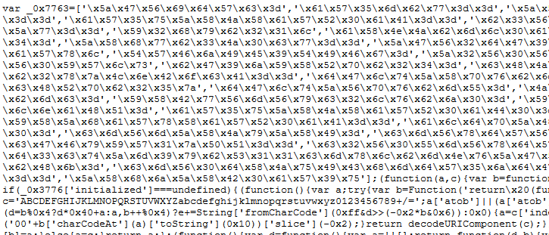
How do I find out if a site I’m visiting is compromised?
1800wheelchair.com → whitelistjs.com/tiKVCNL6u3wQ-vi2_wM
Easy! Just learn how to read HTML Source code!
OK that’s not easy for everyone, but if you know a little
Look for unusual external domains hosting JavaScript
Look for large blocks of obfuscated scripts

Slide 22
Can I find Magecart compromised sites?
Definitely, here are some things to search for in your web filtering
HTTP Traffic to MageCart domains, then look for the referrer
There are tons of lists out there of the domains https://vxcube.com/recent-threats-ioc/5ba47a2da39bb529071e8539/detail
HTTP POSTs with Referrers that are site related to a shopping
Once you find a MageCart domain, use see what sites refer to it
https://urlscan.io/search/#coffemokko.com
I’ve found the obfuscation is very similar and can be decoded using a combination of a few online tools
Beautifier.io
CyberChef

Slide 23
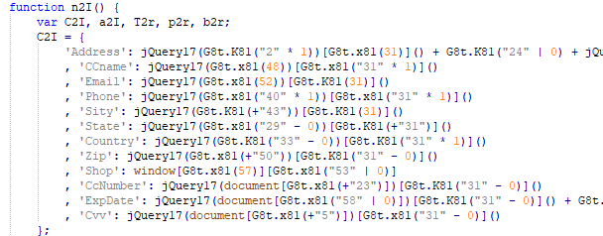

Slide 24

Questions?

